Slide 1
Employee Data Analysis
STUISTER NAME : MOHAMMED KHADEER .M.R
REGESTER NUMBER : 312212981
DEPARTMENT : B.COM GENERAL
COLLEGE NAME : VEL TECH RANGA SANKU ARTS AND SCIENCE COLLEGE

Slide 2
PROJECT TITLE
EMPLOYEE PERFORMANCE ANALYSIS USING EXCEL

Slide 3
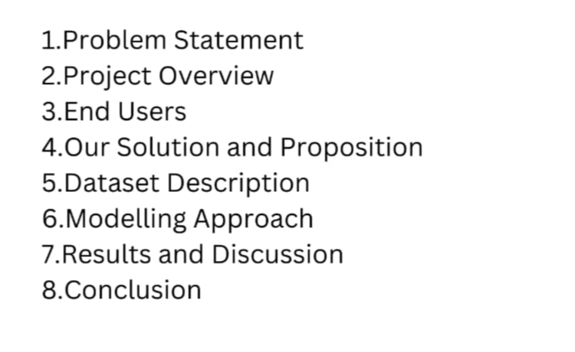
AGENDA

Slide 4
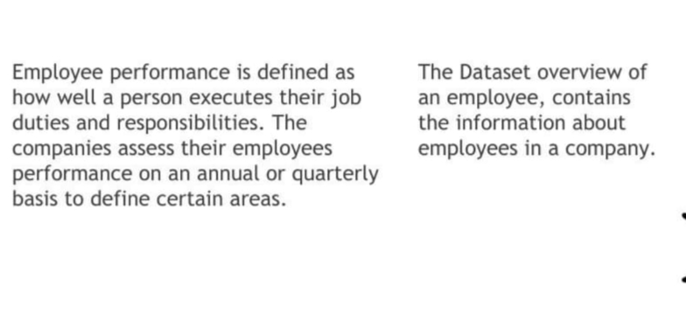
pROBLEM STATEMENT

Slide 5
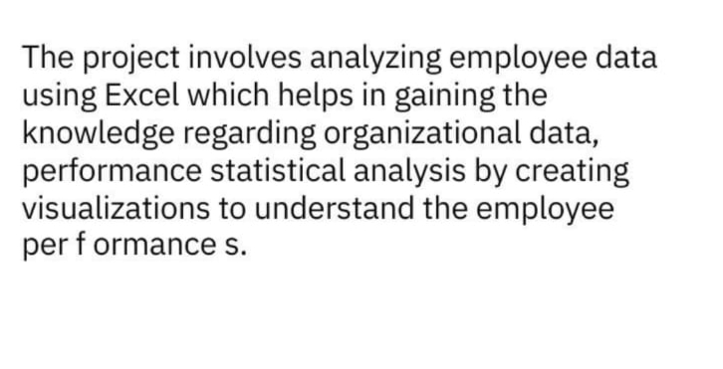
PROJECT OVERVIEW

Slide 6
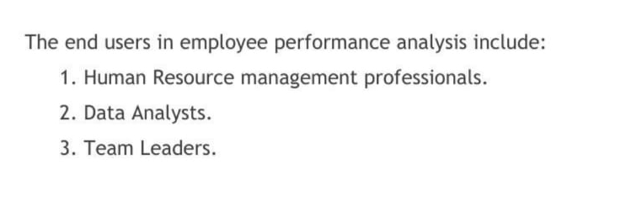
WHO ARE THE END USER ?

Slide 7
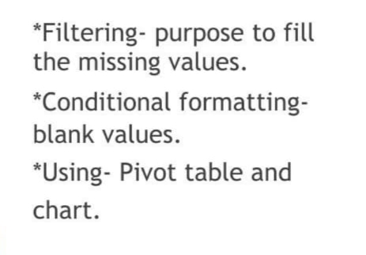
OUR SOLUTION AND ITS VALUE PROPOSITION

Slide 8
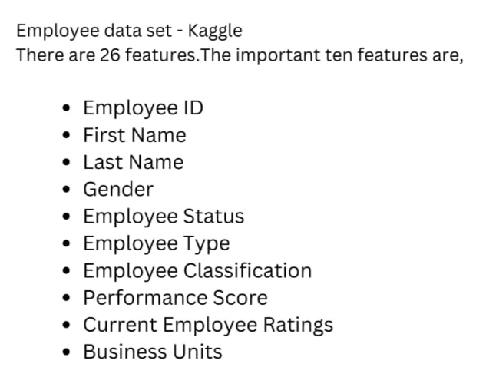
DATASET DESCRIPTION

Slide 9
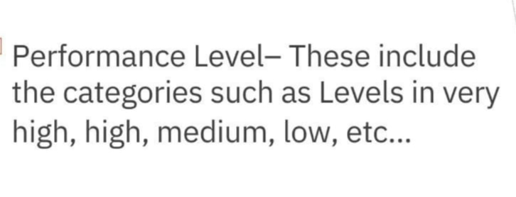
THE “WOW” IN OUR SOLUTION

Slide 10
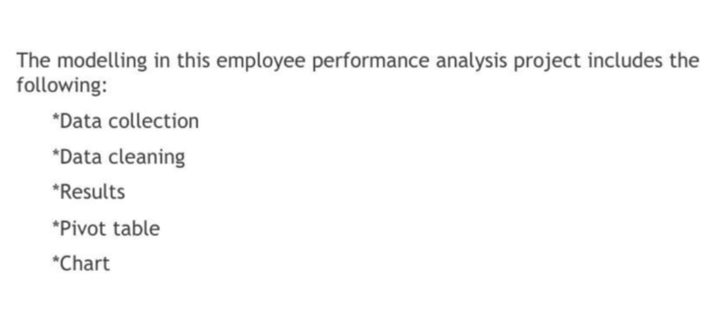
MODELLING

Slide 11
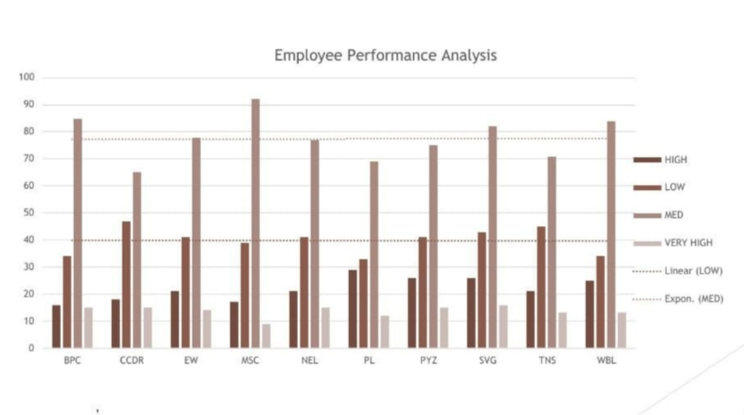
RESULTS

Slide 12
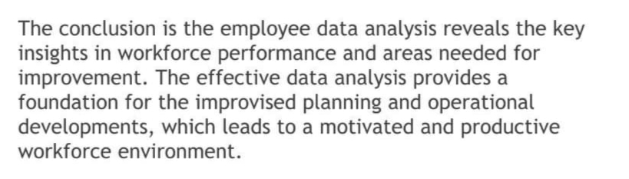
CONCLUSION

